Slide 1

Machine Learning
Session 2
Numpy and matplotlib

Slide 2

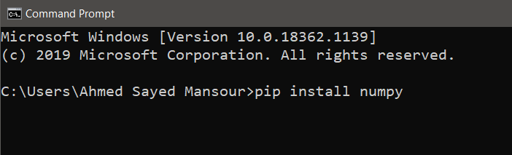
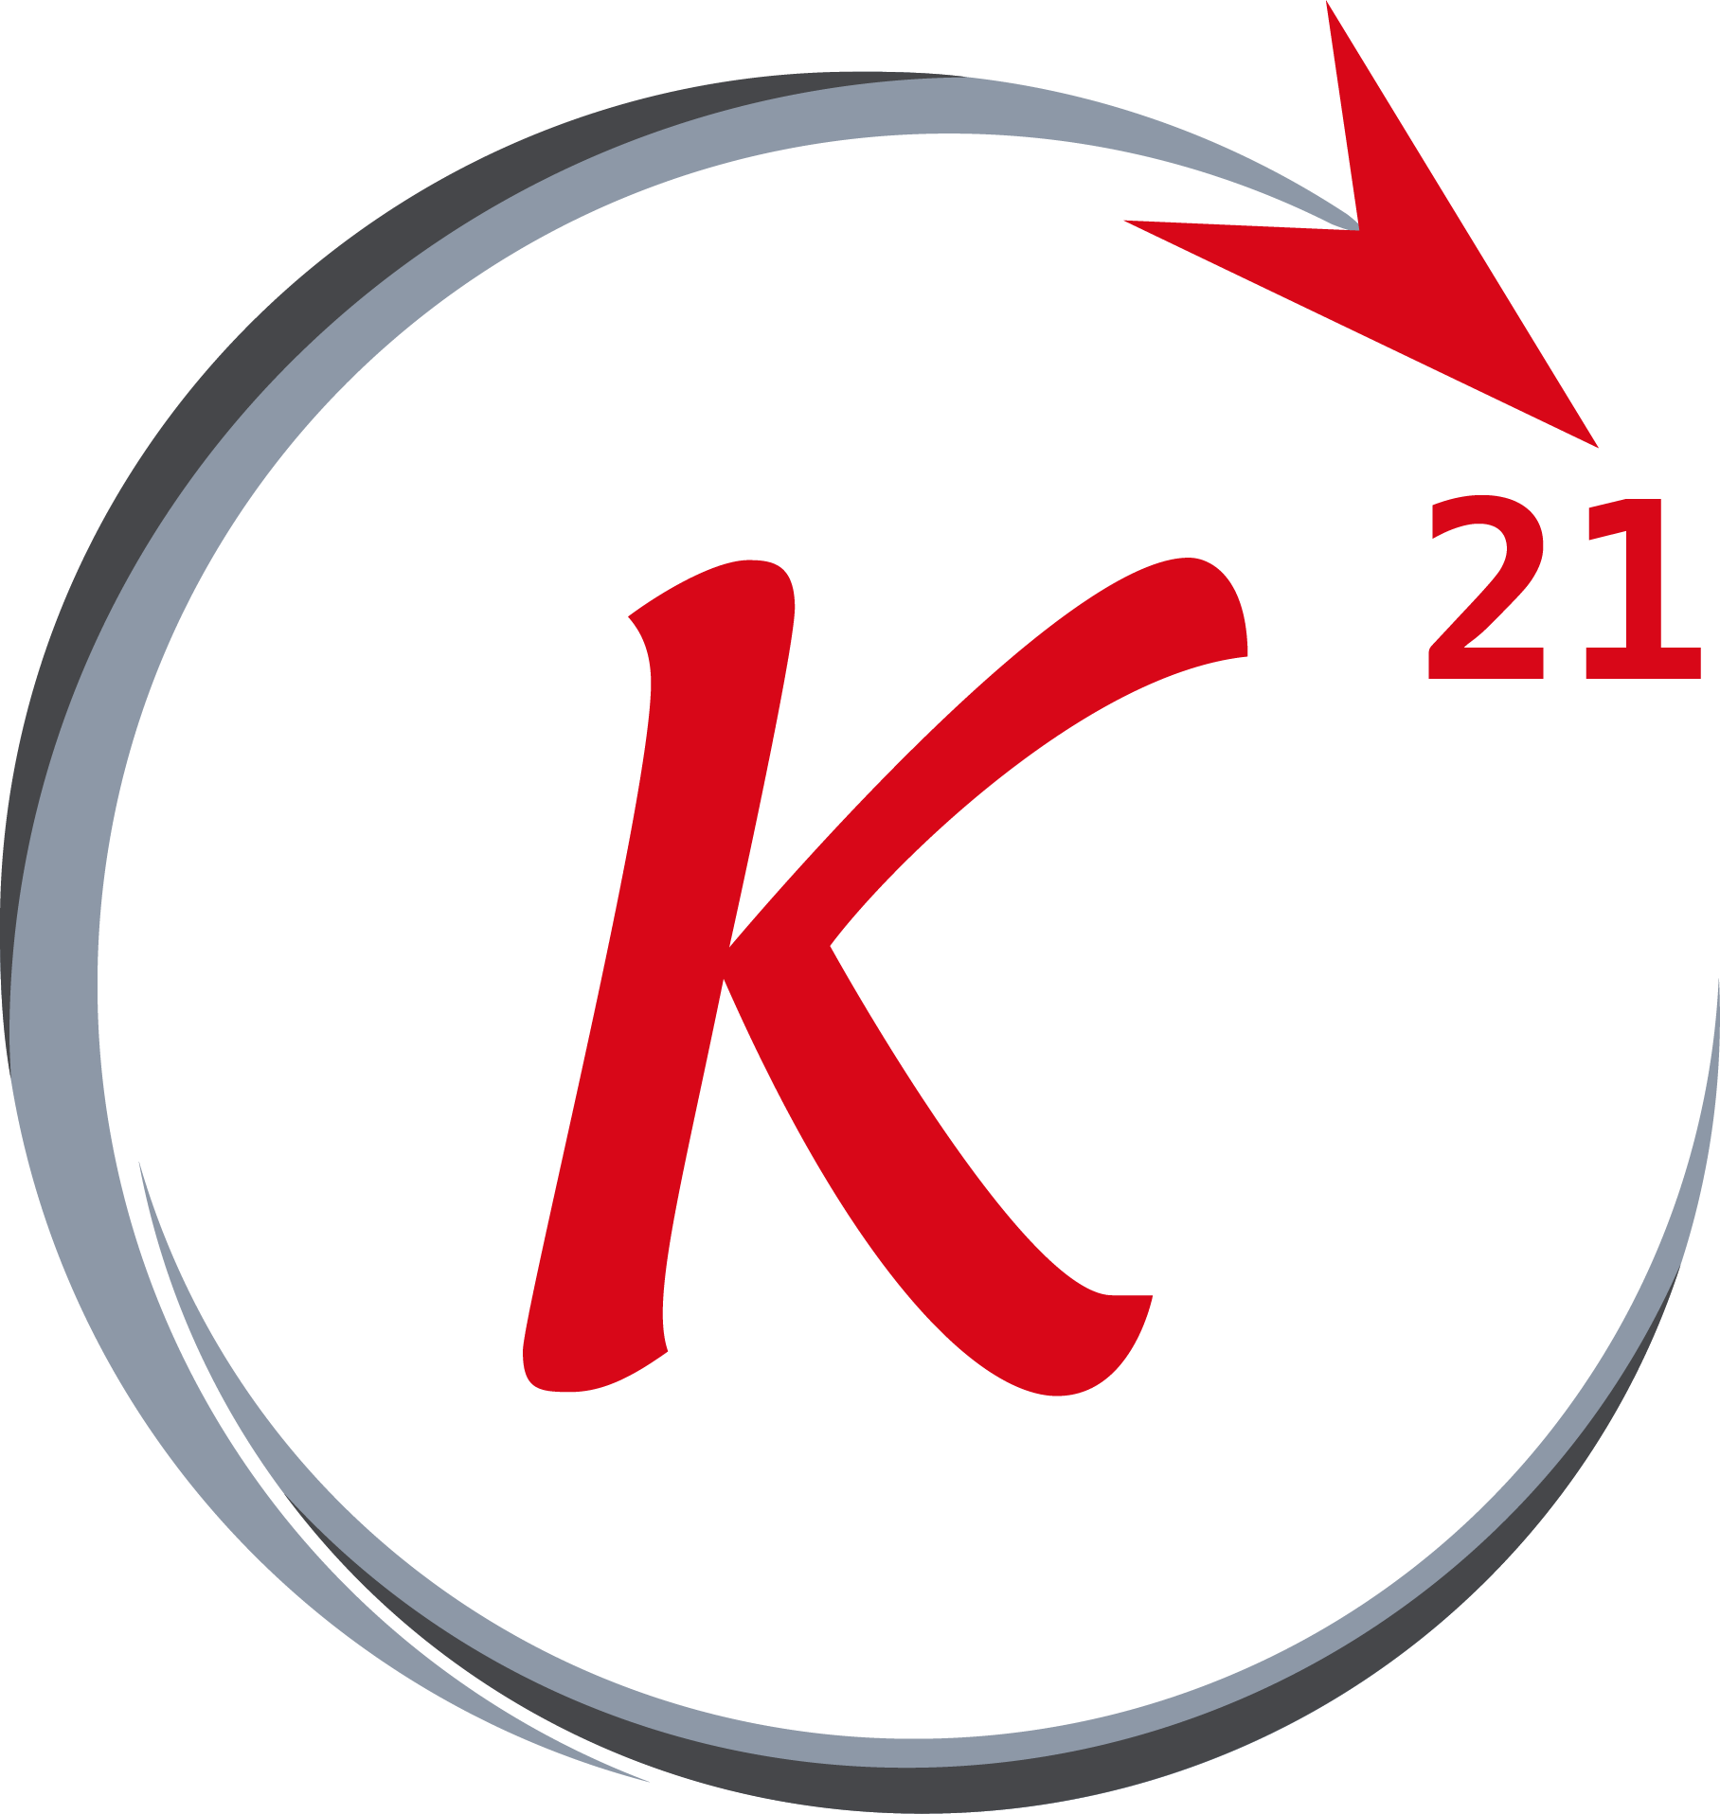


Session 2
NumPy (definition, installation)
Definition:
NumPy is a python library used for working with arrays.
It also has functions for working in domain of linear algebra, Fourier transform, and matrices.
Installation: from your command prompt write pip install numpy
Grow Through

Slide 3

Session 2
NumPy (importing)
import numpy arr = numpy.array([1, 2, 3, 4, 5]) print(arr)
import numpy as np arr = np.array([1, 2, 3, 4, 5]) print(arr)
Grow Through

Slide 4
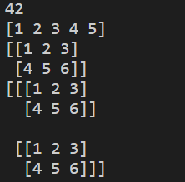
Session 2
NumPy (Arrays)
import numpy as np
#0D array
arr = np.array(42)
print(arr)
#1D array
arr = np.array([1, 2, 3, 4, 5])
print(arr)
#2D array
arr = np.array([[1, 2, 3], [4, 5, 6]])
print(arr)
#3D array
arr = np.array([[[1, 2, 3], [4, 5, 6]], [[1, 2, 3], [4, 5, 6]]])
print(arr)
Grow Through

Slide 5
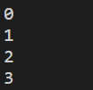
Session 2
NumPy (ndim)
import numpy as np
#0D array
arr = np.array(42)
print(arr.ndim)
#1D array
arr = np.array([1, 2, 3, 4, 5])
print(arr.ndim)
#2D array
arr = np.array([[1, 2, 3], [4, 5, 6]])
print(arr.ndim)
#3D array
arr = np.array([[[1, 2, 3], [4, 5, 6]], [[1, 2, 3], [4, 5, 6]]])
print(arr.ndim)
Grow Through

Slide 6
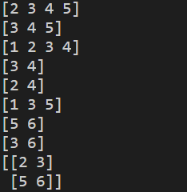
Session 2
NumPy (Slicing)
import numpy as np
#1D array
arr = np.array([1, 2, 3, 4, 5])
print(arr[1:5])
print(arr[2:])
print(arr[:4])
print(arr[-3:-1])
print(arr[1:5:2])
print(arr[::2])
#2D array
arr = np.array([[1, 2, 3], [4, 5, 6]])
print(arr[1, 1:4])
print(arr[0:2, 2])
print(arr[0:2, 1:4])
Grow Through

Slide 7
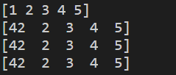
Session 2
NumPy (copy vs view)
import numpy as np
arr = np.array([1, 2, 3, 4, 5])
#Copy
copy = arr.copy()
copy[0] = 42
print(arr)
print(copy)
#View
view = arr.view()
view[0] = 42
print(arr)
print(view)
Grow Through

Slide 8
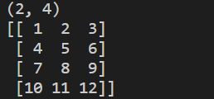
Session 2
NumPy (Shape and Reshape)
import numpy as np
#Shape
arr = np.array([[1, 2, 3, 4], [5, 6, 7, 8]])
print(arr.shape)
#Reshape
arr = np.array([1, 2, 3, 4, 5, 6, 7, 8, 9, 10, 11, 12])
newarr = arr.reshape(4, 3)
print(newarr)
Grow Through

Slide 9
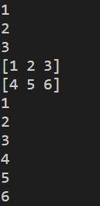
Session 2
NumPy (Iterating)
import numpy as np
#1D
arr = np.array([1, 2, 3])
for x in arr:
print(x)
#2D
arr = np.array([[1, 2, 3], [4, 5, 6]])
for x in arr:
print(x)
for x in arr:
for y in x:
print(y)
Grow Through

Slide 10
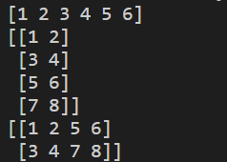
Session 2
NumPy (Array Join)
import numpy as np
#1D
arr1 = np.array([1, 2, 3])
arr2 = np.array([4, 5, 6])
arr = np.concatenate((arr1, arr2))
print(arr)
#2D
arr1 = np.array([[1, 2], [3, 4]])
arr2 = np.array([[5, 6], [7, 8]])
arr = np.concatenate((arr1, arr2), axis=0)
print(arr)
arr = np.concatenate((arr1, arr2), axis=1)
print(arr)
Grow Through

Slide 11
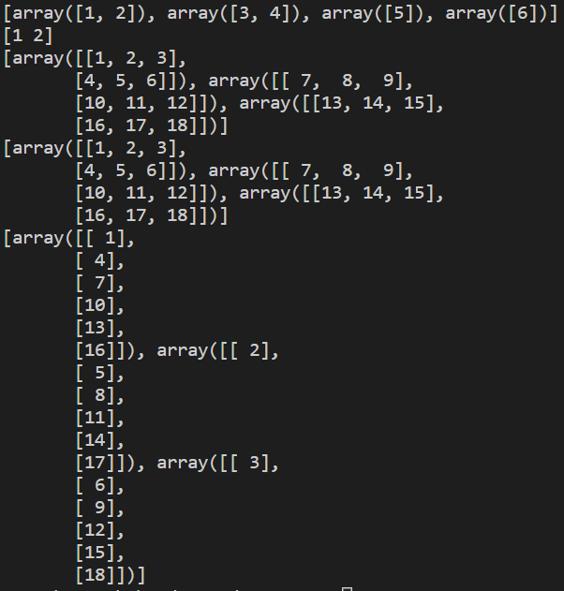
Session 2
NumPy (Array Split)
import numpy as np
#1D
arr = np.array([1, 2, 3, 4, 5, 6])
newarr = np.array_split(arr, 4)
print(newarr)
print(newarr[0])
#2D
arr = np.array([[1, 2, 3], [4, 5, 6], [7, 8, 9], [10, 11, 12], [13, 14, 15], [16, 17, 18]])
newarr = np.array_split(arr, 3)
print(newarr)
newarr = np.array_split(arr, 3, axis=0)
print(newarr)
newarr = np.array_split(arr, 3, axis=1)
print(newarr)
Grow Through

Slide 12

Session 2
NumPy (Array where and sort)
import numpy as np
arr = np.array([5, 6, 3, 4, 5, 4, 4])
x = np.where(arr == 4)
print(x)
x = np.where(arr%2 == 0)
print(x)
arr2 = np.sort(arr)
print(arr2)
Grow Through

Slide 13
Session 2
NumPy (Array Filter)
import numpy as np
arr = np.array([1, 2, 3, 4, 5, 6, 7])
# Create an empty list
filter_arr = []
# go through each element in arr
for element in arr:
if element % 2 == 0:
filter_arr.append(True)
else:
filter_arr.append(False)
newarr = arr[filter_arr]
print(filter_arr)
print(newarr)
Grow Through

Slide 14
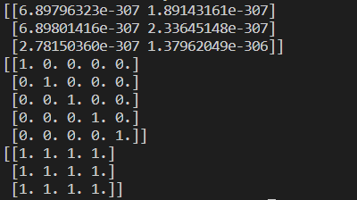
Session 2
NumPy (empty, identity and ones):
import numpy as np
## create an empty array of size 3*2
arr = np.empty((3,2))
print(arr) ## non initialized array
## create identity matrix of size 5*5
#### (Remember, identity matrix has 1s on diagonals and 0s otherwise, and it is always a square matrix)
identity = np.eye(5)
print(identity)
## create array full of 1s of size 3*4
all_ones = np.ones((3, 4))
print(all_ones)
Grow Through

Slide 15
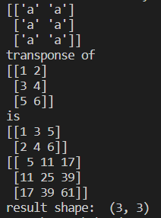
Session 2
NumPy (full, transpose and dot):
import numpy as np
## full
all_a = np.full((3,2), 'a')
print(all_a)
## Transposing a matrixc is mat.T:
mat = np.array([ [1, 2], [3, 4], [5, 6]])
print('transponse of ', mat, 'is', mat.T, sep='\n')
## Matrix by Matrix Multiplication using np.dot:
mat1 = np.array([ [1, 2], [3, 4], [5, 6]]) ## of shape 3*2
mat2 = np.array([[1, 3, 5], [2, 4, 6]]) ## of shape 2*3
## result matrix is of shape 3*3
mat1_by_mat2 = np.dot(mat1, mat2) ## rememeber, inner dimensions must be the similar
print(mat1_by_mat2)
print('result shape: ', mat1_by_mat2.shape)
Grow Through

Slide 16
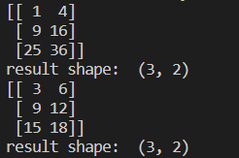
Session 2
NumPy (the asterisk *):
import numpy as np
## the astrisk * is used for element-wise multiplication
mat1 = np.array([ [1, 2], [3, 4], [5, 6]]) ## of shape 3*2
mat2 = np.array([ [1, 2], [3, 4], [5, 6]]) ## of shape 3*2
mat1_elements_by_mat2_elements = mat1*mat2 ## they MUST be of the same size
print(mat1_elements_by_mat2_elements)
print('result shape: ', mat1_elements_by_mat2_elements.shape)
mat1_elements_by_3 = mat1*3
print(mat1_elements_by_3)
print('result shape: ', mat1_elements_by_3.shape)
Grow Through

Slide 17
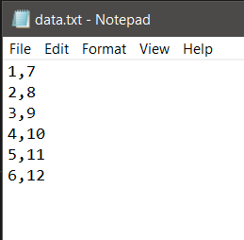

Session 2
NumPy (loadtxt):
numpy.loadtxt(fname, dtype=<type 'float'>, comments='#', delimiter=None, converters=None, skiprows=0, usecols=None, unpack=False, ndmin=0)
import numpy as np
datafile = 'data.txt'
arr = np.loadtxt(datafile,dtype=int,delimiter=',',usecols=None,unpack=True)
print(arr)
Grow Through

Slide 18
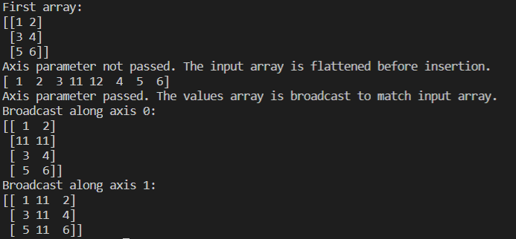
Session 2
NumPy (Insert):
numpy.insert(arr, obj, values, axis)
Note:The axis along which to insert. If not given, the input array is flattened
import numpy as np
a = np.array([[1,2],[3,4],[5,6]])
print('First array:')
print(a)
print('Axis parameter not passed. The input array is flattened before insertion.')
print( np.insert(a,3,[11,12]) )
print('Axis parameter passed. The values array is broadcast to match input array.')
print('Broadcast along axis 0:' )
print( np.insert(a,1,[11],axis = 0) )
print( 'Broadcast along axis 1:' )
print( np.insert(a,1,11,axis = 1) )
Grow Through

Slide 19
Session 2
Matplotlib (def, install and import):
Matplotlib is a low level graph plotting library in python that serves as a visualization utility.
import matplotlib
Grow Through

Slide 20
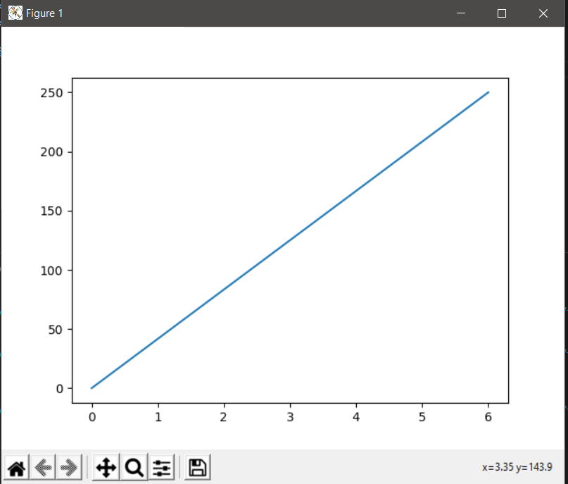
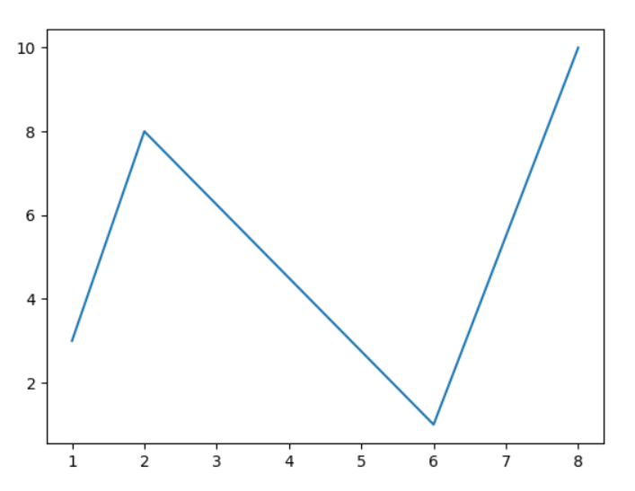
Session 2
Matplotlib (Pyplot):
import matplotlib.pyplot as plt
import numpy as np
xpoints = np.array([0, 6])
ypoints = np.array([0, 250])
plt.plot(xpoints, ypoints)
plt.show()
xpoints = np.array([1, 2, 6, 8])
ypoints = np.array([3, 8, 1, 10])
plt.plot(xpoints, ypoints)
plt.show()
Grow Through

Slide 21
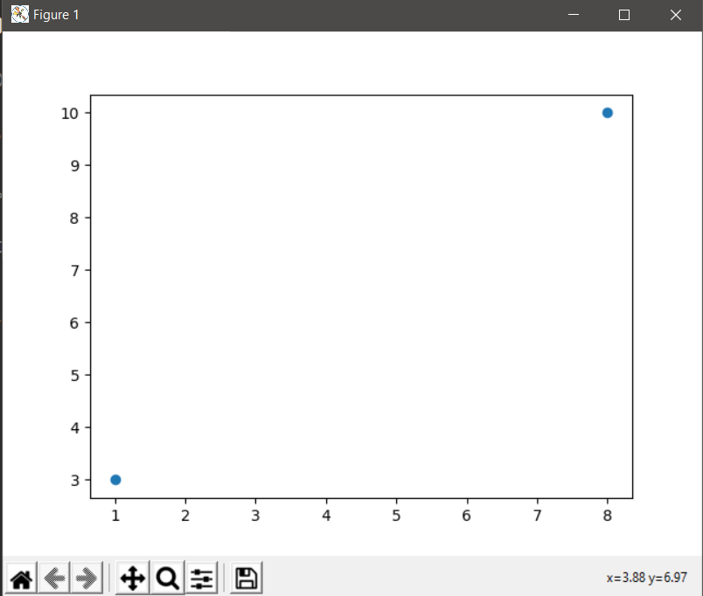
Session 2
Matplotlib (Pyplot):
import matplotlib.pyplot as plt
import numpy as np
xpoints = np.array([1, 8])
ypoints = np.array([3, 10])
plt.plot(xpoints, ypoints, ‘0’)
plt.show()
Grow Through

Slide 22
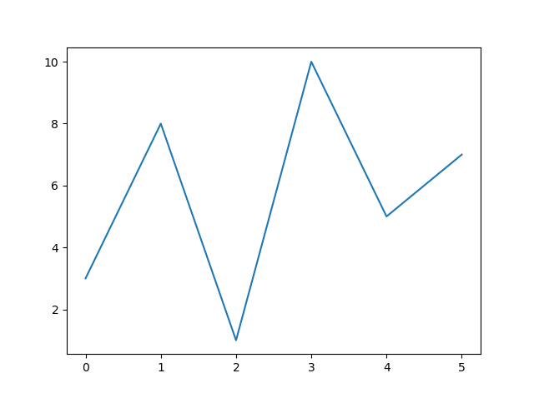
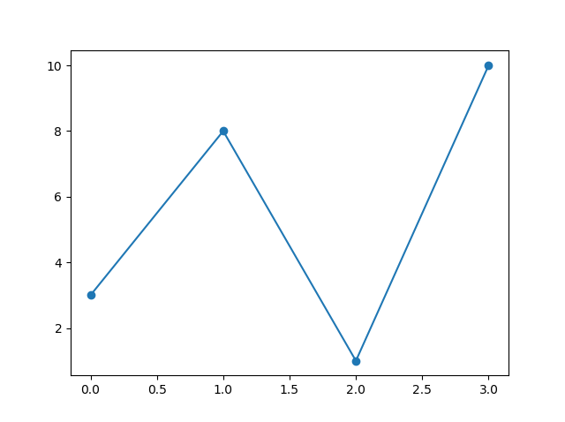
Session 2
Matplotlib (Pyplot default x-points):
import matplotlib.pyplot as plt
import numpy as np
ypoints = np.array([3, 8, 1, 10, 5, 7])
plt.plot(ypoints)
plt.show()
ypoints = np.array([3, 8, 1, 10])
plt.plot(ypoints, marker = 'o')
plt.show()
Grow Through

Slide 23
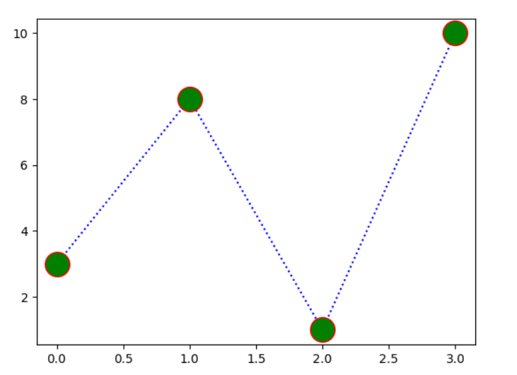
Session 2
Matplotlib (Pyplot variables):
import matplotlib.pyplot as plt
import numpy as np
ypoints = np.array([3, 8, 1, 10])
plt.plot(ypoints, 'o:b', ms = 20, mec = 'r', mfc = 'g')
plt.show()
Grow Through

Slide 24
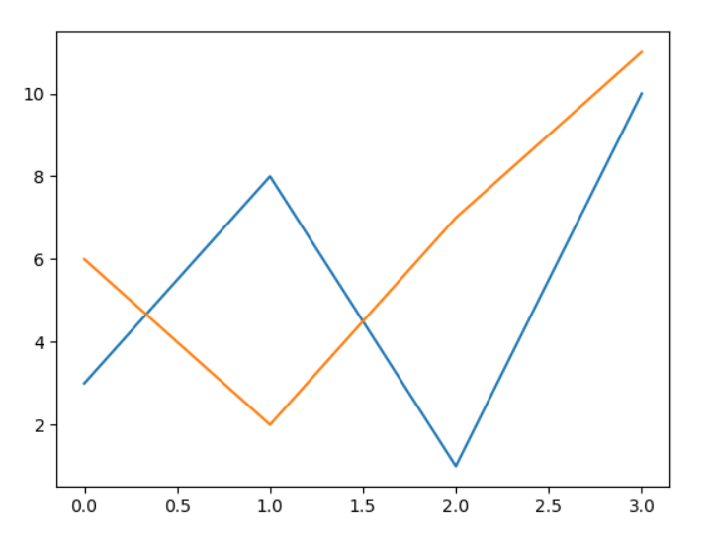
Session 2
Matplotlib (Pyplot):
import matplotlib.pyplot as plt
import numpy as np
x1 = np.array([0, 1, 2, 3])
y1 = np.array([3, 8, 1, 10])
x2 = np.array([0, 1, 2, 3])
y2 = np.array([6, 2, 7, 11])
plt.plot(x1, y1, x2, y2)
plt.show()
Grow Through

Slide 25
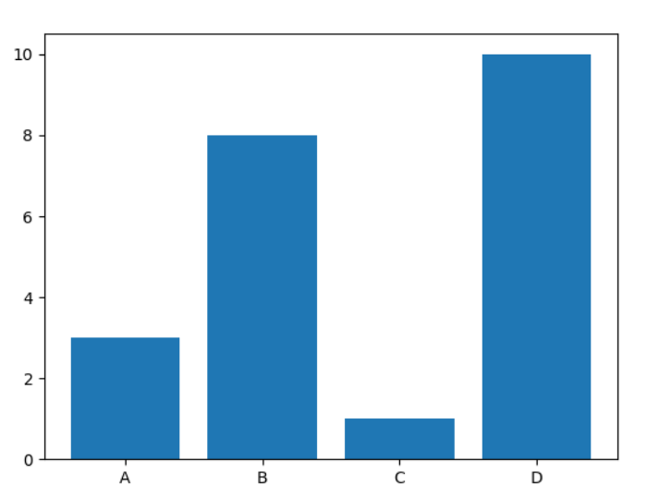
Session 2
Matplotlib (Pyplot Bar):
import matplotlib.pyplot as plt
import numpy as np
x = np.array(["A", "B", "C", "D"])
y = np.array([3, 8, 1, 10])
plt.bar(x,y)
plt.show()
Grow Through

Slide 26
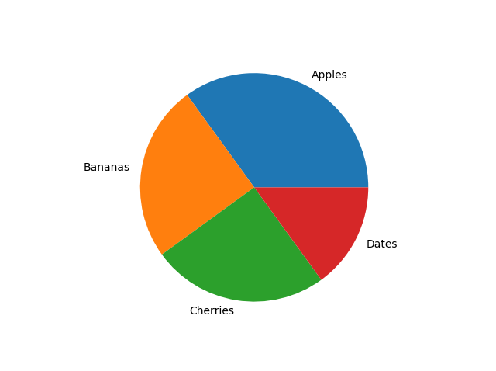
Session 2
Matplotlib (Pyplot Pie chart):
import matplotlib.pyplot as plt
import numpy as np
y = np.array([35, 25, 25, 15])
mylabels = ["Apples", "Bananas", "Cherries", "Dates"]
plt.pie(y, lables = mylabels)
plt.show()
Grow Through

Slide 27
Session 2
Matplotlib (Pyplot Pie chart):
import matplotlib.pyplot as plt
import numpy as np
y = np.array([35, 25, 25, 15])
mylabels = ["Apples", "Bananas", "Cherries", "Dates"]
plt.pie(y, lables = mylabels)
plt.show()
Grow Through

Slide 28
Goodbye
Grow Through

